Slide 1
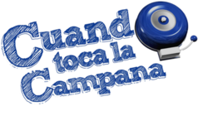
Responda a las siguientes en frases completas españolas:
¿Cuál es la ciudad capital de Cuba?
¿Dónde está Cuba?
¿Cuál es la ciudad capital de La República Dominicana?
¿Dónde está La República Dominicana?
¿Cuál es la nacionalidad de Puerto Rico?
¿Dónde está Puerto Rico?
*Note: We will use Prácticas instead of Procesos*

Slide 2
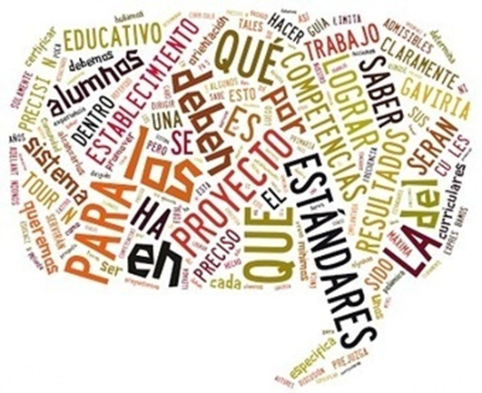
Hoy vamos a…
Unit 3
Examen: lunes el 18 de septiembre (18/9/2017)
Themes/Topics:
Hacer el trabajo de la campana
Aprender de Hispanic Heritage Month
Aprender de Las Antillas:
Puerto Rico
La República Dominicana
Cuba
Hispanic Heritage Month
Geography of 21 Spanish-speaking countries with nationalities
Culture
2.1, 2.2, 3.1, 3.2, 4.1, 4.2, & 5.1

Slide 3
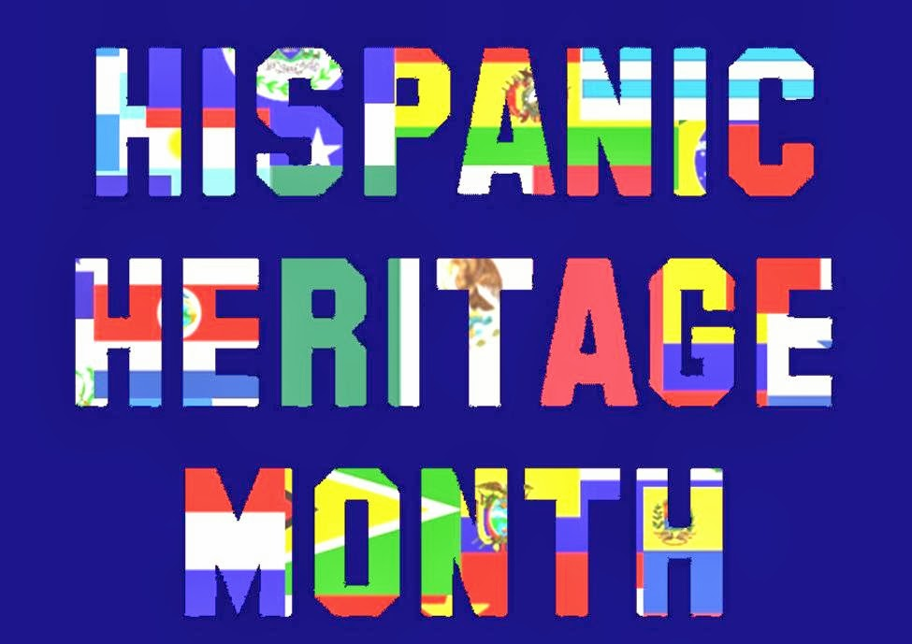
HISPANIC HERITAGE MONTH

Slide 4
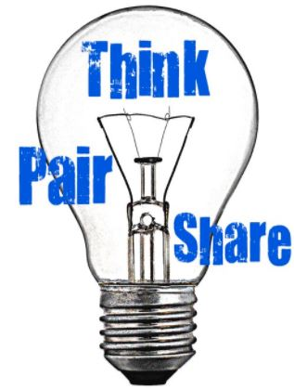
What is Hispanic Heritage Month?
Who celebrates Hispanic Heritage Month?
When is Hispanic Heritage Month?

Slide 5
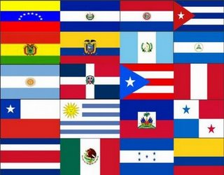
Hispanic Heritage Month is a US celebration & takes place each year from September 15 – October 15.

Slide 6
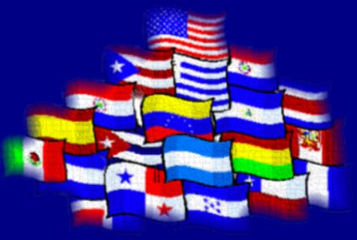
The observation started in 1968 as Hispanic Heritage Week under President Lyndon Johnson & was expanded by President Ronald Reagan to cover a 30-day period starting on September 15 & ending on October 15. It was enacted into law on August 17, 1988.

Slide 7
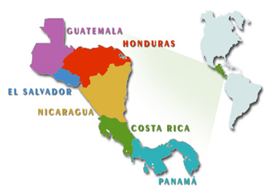
September 15 was chosen as the starting point for the celebration because it is the anniversary of the independence of five Latin American countries:
Costa Rica, El Salvador, Guatemala, Honduras, & Nicaragua
They all declared their independence from Spain September 15, 1821.

Slide 8
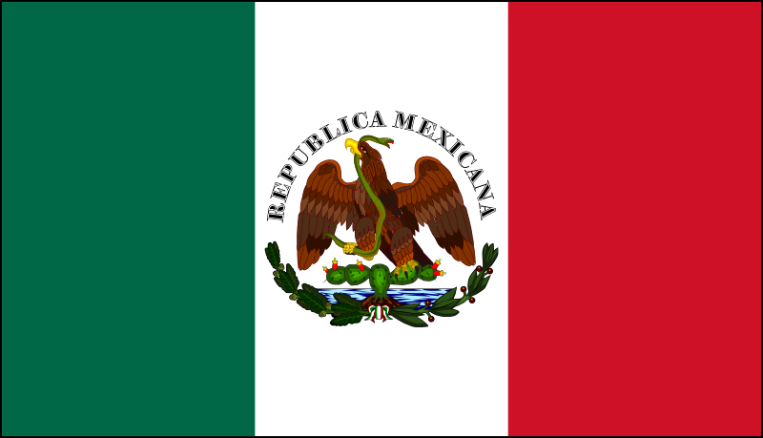
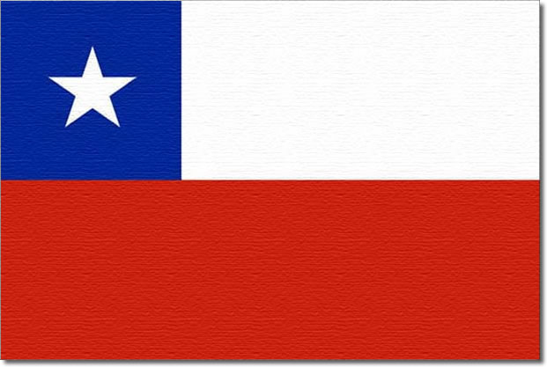
Mexico & Chile celebrate their independence days on September 16 & September 18, respectively.
Also, Columbus Day or Día de la Raza, which is October 12, falls
within this 30 day period.

Slide 9
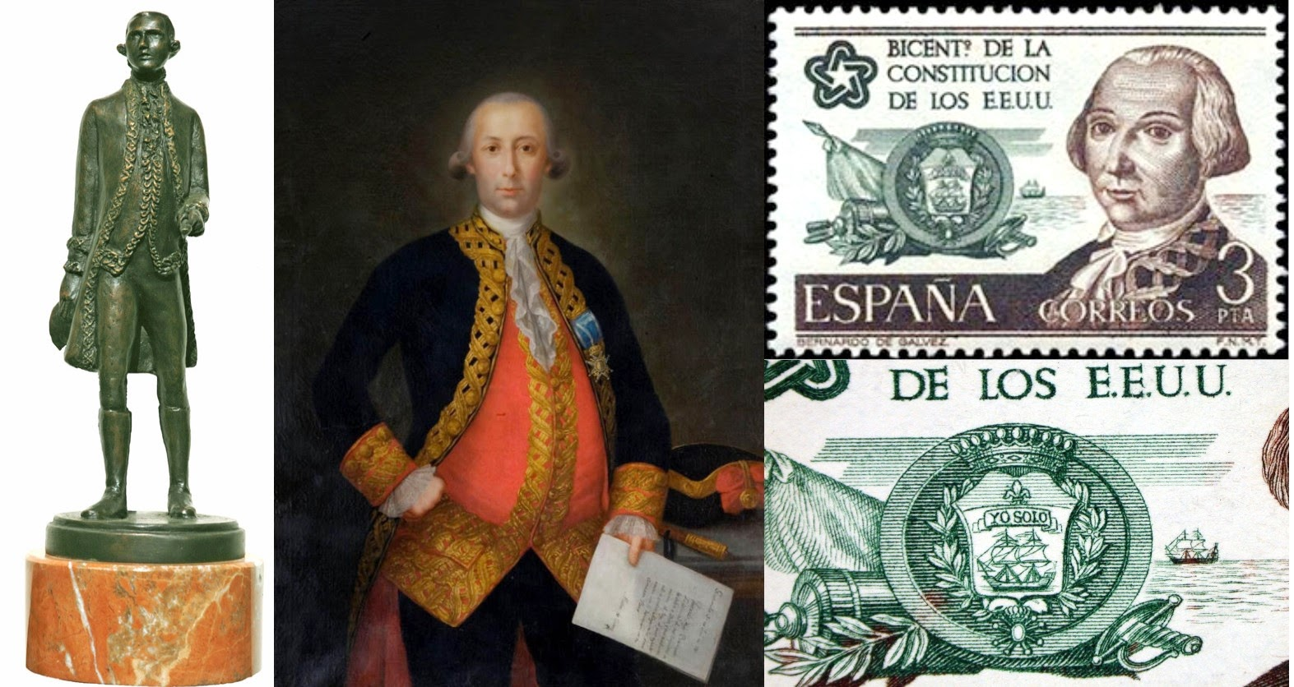
The purpose of Hispanic Heritage Month is to recognize the contributions of Hispanic Americans to the United States & celebrate their heritage & culture.
Notes:
http://www.huffingtonpost.com/stephen-balkaran/hispanic-heritage-month-b_b_5848568.html
During the American Revolutionary War, Bernardo de Galvez, governor of the Louisiana Territory, along with support and reinforcements from Spain’s Cuba, Mexico and Puerto Rico, sent gunpowder, rifles, bullets, blankets, medicine and other supplies to the armies of General George Washington in support of America’s cause..
The Hispanic presence in the election of President James Polk in 1844 and his future policy of annexation of Texas, the creation of the artificial border, the Alamo, the great Southwest, and the Compromise of 1850 all help define our American history. What would America be like without the importance of The Treaty of Guadalupe Hidalgo, which ended the Mexican War, where the United States gained not only Texas, New Mexico and Upper California, making way for the vast expansion of American land, but also a cultural history like no other?
Our Civil War would not be the same without the presence of Hispanics, often removed from our history books. Some 20,000 Hispanics fought in the Civil War, some serving in the 1st Florida Cavalry, others serving in the Union forces in Connecticut, New York and Massachusetts.
Very few understand the importance of Mendez v. Westminster in 1947, which the US Courts of Appeals ruled that segregation of Mexican American children from the public schools system in California was unconstitutional and violated the 14th Amendment, it paved the way for the Brown v. Board of Education decision in 1954.
The civil rights leader of the Hispanic movement in the 1940’s-1950’s, Dr. Hector P. Garcia’s, ideology and commitment towards justice for all later became the cornerstone for Dr. Martin L. King and the African American Struggle for Civil Rights in the 1960s.
What would our first African American president campaign slogan “Yes We Can” be like without the Cesar Chavez and Dolores Huerta who coined the term “Sí, se puede” in the 1972 during the farm workers strike? Without the Hispanic struggle for economic equality, the term may not have had any importance.
What would happen to the major philosophical question “what happen to the dinosaurs?” Without Hispanic physicist Luis Alvarez’s theory on the asteroid that destroyed the dinosaurs some 65 million years ago, that frequently asked question would still be unanswered.
What would America’s past time, baseball, be without the Hispanic influence helping change and define the game? From Roberto Clemente to the greatest hitter of all time, Ted Williams and his Hispanic background? Yes, his mother was Mexican, and though he shied away from the fact of his Hispanic heritage, many argue that it would affect his status and playing career.
From the Cuban rhythms in South Florida to the Puerto Ricans, Dominicans, Peruvians, Central Americans, Bolivians, Colombians and other cultural influences in New York City, Chicago and Boston to the Mexican culture found in the great Southwest, Texas and California, America’s cultural history would not be the same.

Slide 10
Hoy vamos a…
Hacer el trabajo de la campana
Aprender de Hispanic Heritage Month
Aprender de Las Antillas:
Puerto Rico
La República Dominicana
Cuba
2.1, 2.2, 3.1, 3.2, 4.1, 4.2, & 5.1

Slide 11
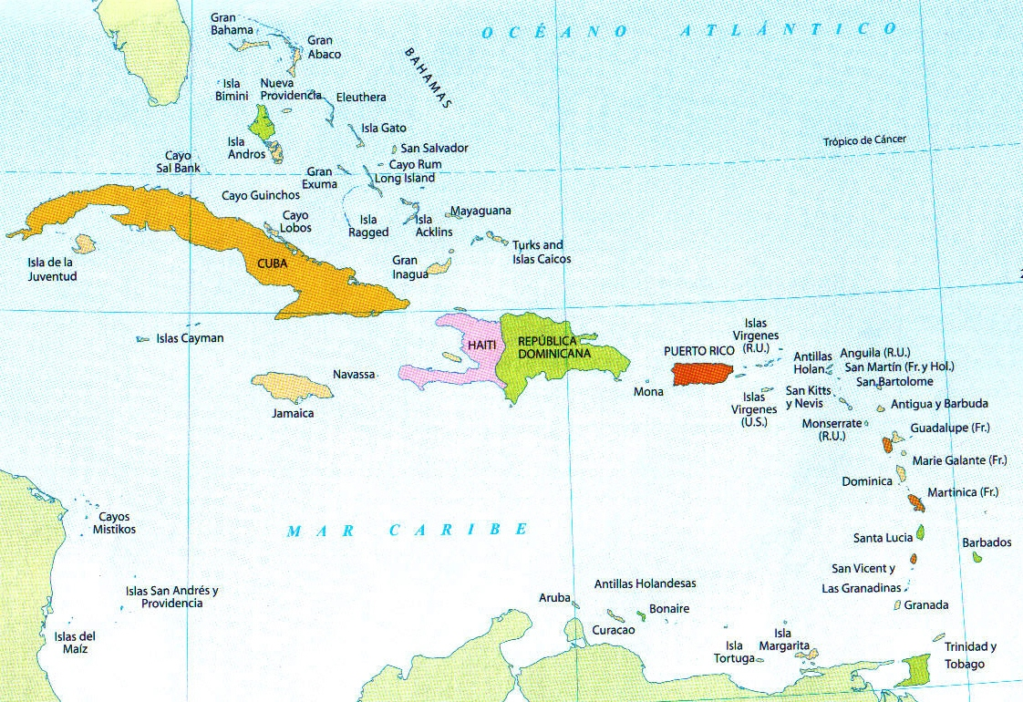
Las Antillas
Cuba, República Dominicana, y Puerto Rico

Slide 12
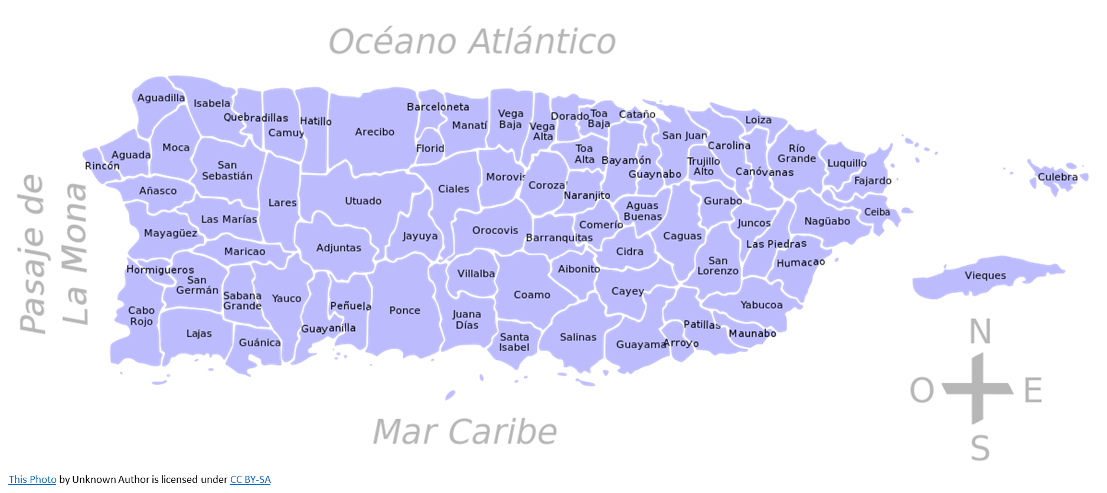
PUERTO RICO

Slide 13
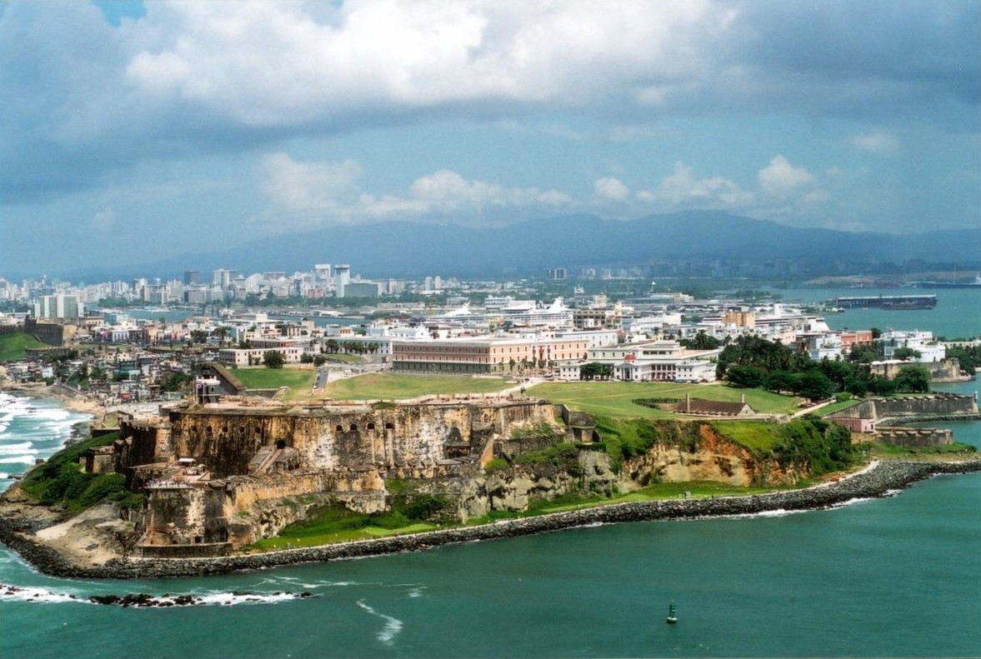
Puerto Rico, whose capital is San Juan, is located in the Caribbean to the east of the Dominican Republic and to the west of the Virgin Islands.

Slide 14
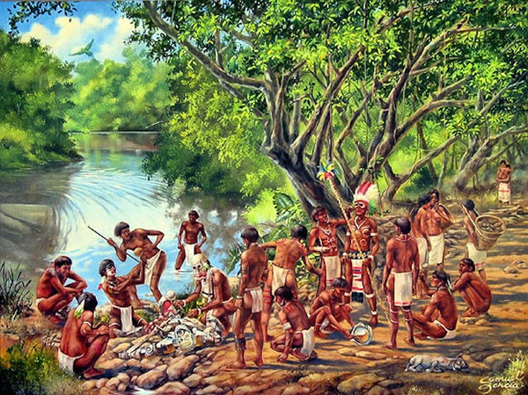
Puerto Ricans often refer to themselves as Boricuas which is a word derived from the Taíno Indian name for the island.

Slide 15
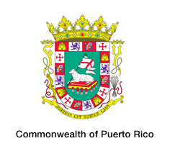
Puerto Rico is a commonwealth of the United States and all Puerto Ricans are U.S. citizens

Slide 16
Famous Puerto Rican musicians include Marc Anthony, Jennifer Lopez, Fat Joe, Ricky Martin, Luis Fonsi & Daddy Yankee.
Notes:
https://www.youtube.com/watch?v=-P8KeFV8HhA

Slide 17
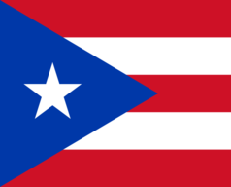
La bandera e independencia
As a U.S. commonwealth, Puerto Rico does not have its own independence day, but rather on July 25, 1952, they became a commonwealth with their own constitution.
The flag is not flown except in company of the U.S. flag. Adopted in July 25, 1952.
The white star stands for the Commonwealth of Puerto Rico while the three sides of the equilateral triangle together represent the three branches of the Republican government (executive, legislative and judicial branches). The three red stripes symbolize the blood that feeds those parts of the government. The two white stripes symbolizing the rights of man and the freedom of the individual, are a perpetual reminder of the need for vigilance of a democratic government is to be preserved.

Slide 18
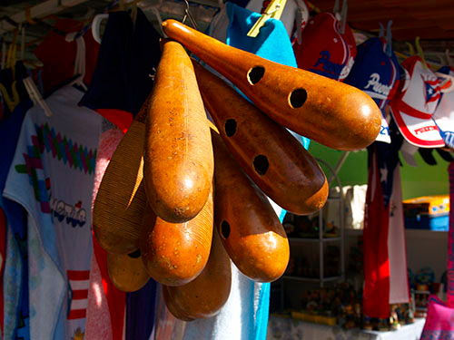
Música en Puerto Rico
Some of the instruments used in traditional Puerto Rican music originated with the Taíno people. Most noteworthy is the güicharo, or güiro, a notched hollowed-out gourd, which was adapted from pre-Columbian days. The musical traditions of the Spanish and Africans can also be heard in Puerto Rico's music.
Puerto Ricans love to dance, but there is not a national dance, & the dances they practice are native to the surrounding island countries (ex. salsa, merengue, etc)

Slide 19
Hoy vamos a…
Hacer el trabajo de la campana
Aprender de Hispanic Heritage Month
Aprender de Las Antillas:
Puerto Rico
La República Dominicana
Cuba
2.1, 2.2, 3.1, 3.2, 4.1, 4.2, & 5.1

Slide 20
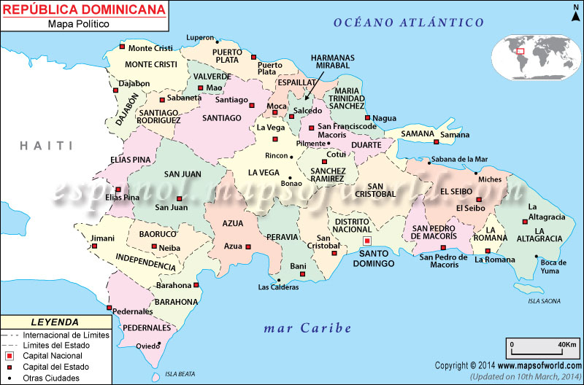
La República Dominicana

Slide 21
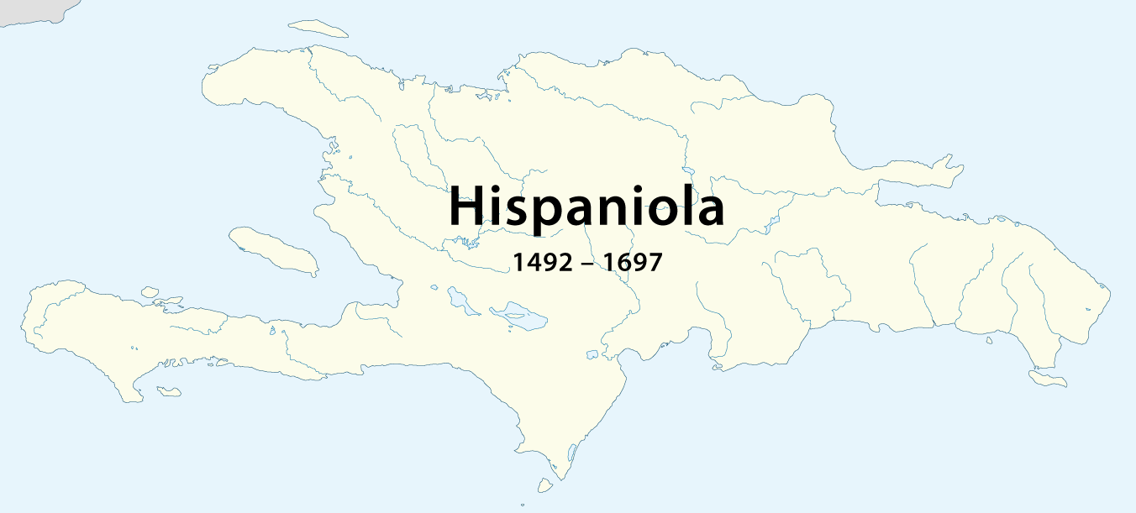
The Dominican Republic makes up the eastern two-thirds of the island
in the Caribbean.

Slide 22
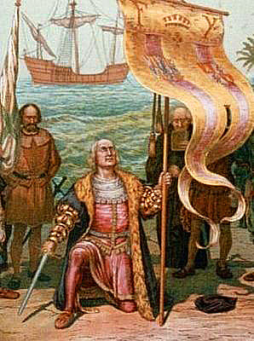
The Dominican Republic was discovered by Christopher Columbus during his first voyage to the Americas in 1492.

Slide 23
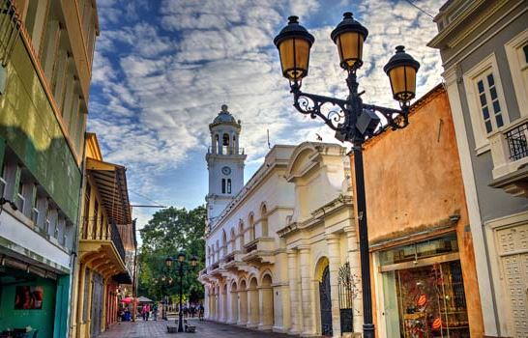
Santo Domingo, the capital of the Dominican Republic, is the oldest city in the ‘new world,’ founded in 1496.

Slide 24
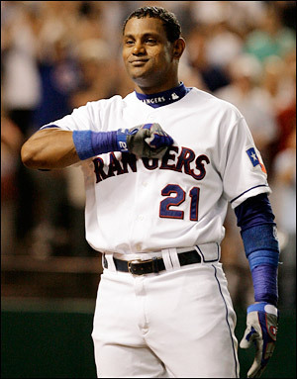
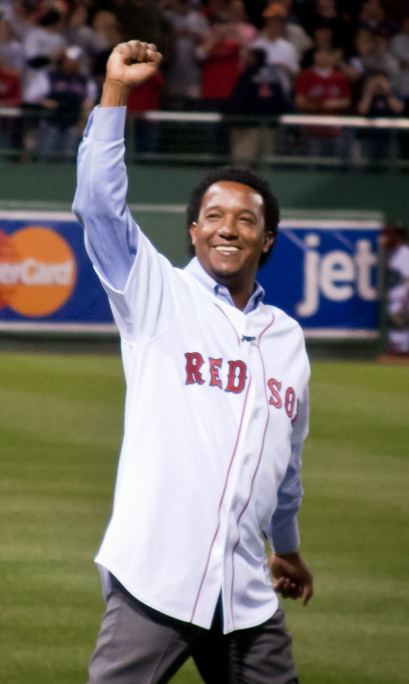
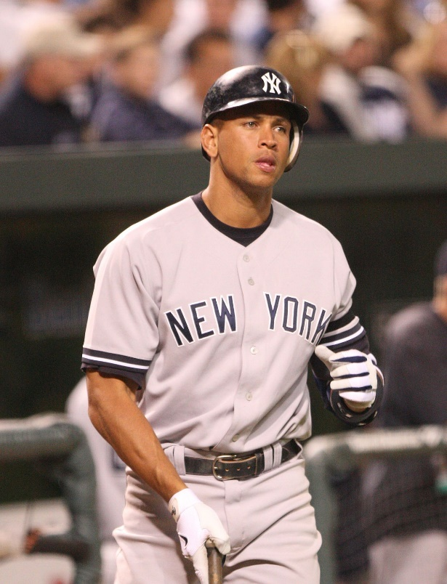
Sammy Sosa, Pedro Martinez, & Alex Rodriguez are all famous Dominican baseball players.
This Photo by Unknown Author is licensed under CC BY-SA

Slide 25
The famous fashion designer
was from the Dominican Republic.

Slide 26
The flag of the Dominican Republic was designed by founding father Juan Pablo Duarte, and adopted in 1844, the same year they declared their independence on February 27. It is centered with a white cross that extends to the edges and divides the flag into four rectangles. The color blue is for liberty, red for the blood of heroes, and white for salvation
The Dominican Republic coat of arms features a shield in quartered colors of the flag, with a laurel branch to the left and a palm frond to the right. The blue ribbon above the shield displays the national motto: Dios, Patria, Libertad (God, Fatherland, Liberty). Below the shield, the words República Dominicana appear on a red ribbon. In the center of the shield, flanked by six spears, is a Bible with a small golden cross above it. Popular belief claims that the pages are opened to the Gospel of John 8:32, which reads, "Y la verdad os hará libre." (And the truth shall make you free.)

Slide 27
El baile nacional dominicano…El Merengue
Notes:
https://www.youtube.com/watch?v=lcPHaV3p6S4 @ 0:37
http://www.centralhome.com/ballroomcountry/merengue.htm
http://www.heritageinstitute.com/danceinfo/descriptions/merengue.htm

Slide 28
Hoy vamos a…
Hacer el trabajo de la campana
Aprender de Hispanic Heritage Month
Aprender de Las Antillas:
Puerto Rico
La República Dominicana
Cuba
2.1, 2.2, 3.1, 3.2, 4.1, 4.2, & 5.1

Slide 29
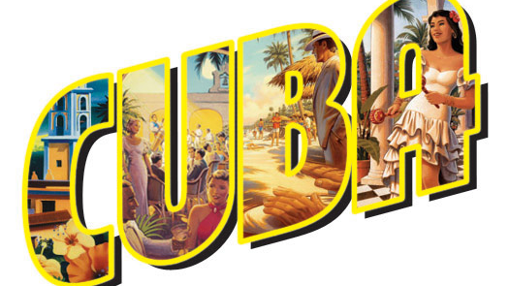

Slide 30
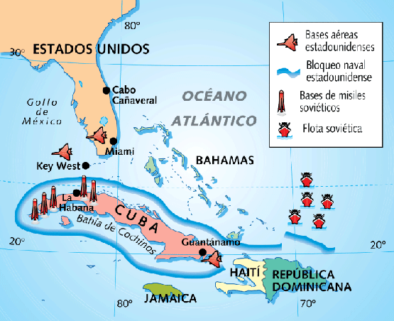
Cuba is located 90 miles south of Florida and its capital is La Habana.

Slide 31
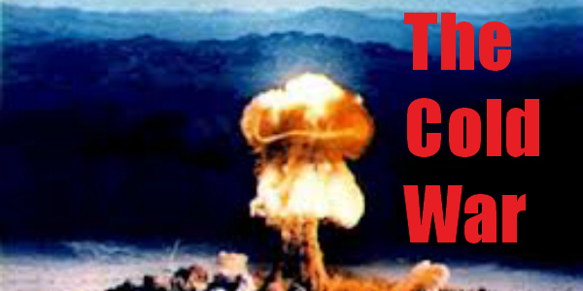
The U.S. has had a trade embargo against Cuba since 1960 due to Cuba’s communistic government & its siding with the Soviet Union during the Cold War.
The Obama administration sought to re-establish relations with Cuba. Some restrictions of the embargo have been loosened but the embargo on trade and tourism remains in place for now.
Notes:
https://www.nytimes.com/2016/10/15/world/americas/obama-cuba-trade-embargo.html?mcubz=1
https://www.usnews.com/news/articles/2016-03-21/obama-castro-call-for-trade-embargo-on-cuba-to-be-lifted

Slide 32
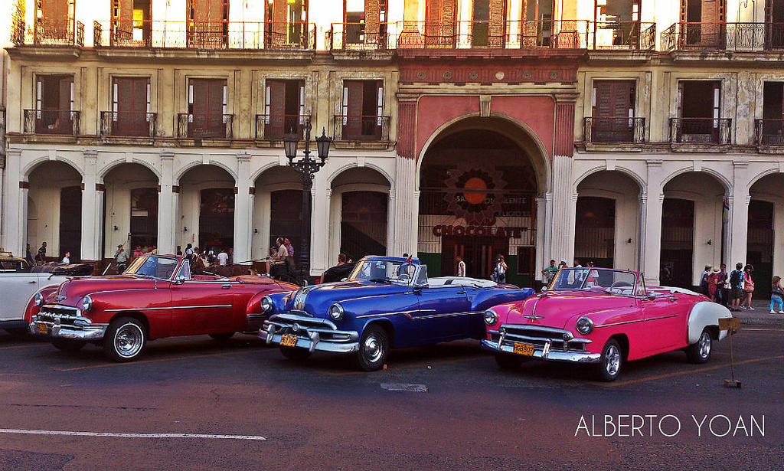
Due to the trade embargo, Cuba is a "living museum" of 1950s American Cadillacs, Chevrolets, etc. which have been kept running since the Revolution.

Slide 33
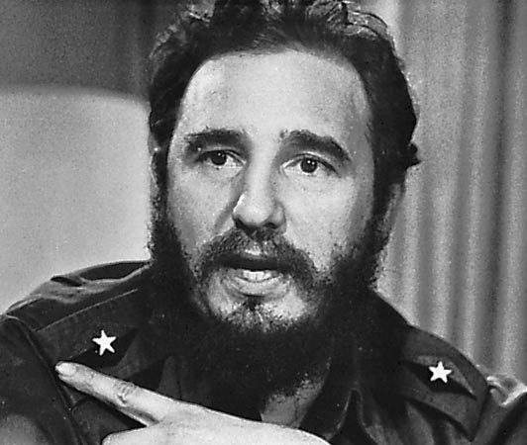
In 2008, after 49 years in power, Fidel Castro passed the Cuban presidency on to his younger brother, Raúl, due to Fidel’s failing health. On November 25, 2016, Fidel Castro passed away.

Slide 34
The Cuban government explains the meaning behind the flag as follows:
the blue stripes refer to the three old divisions of the island
the two white stripes refer to the strength of the independents’ ideal
the red triangle represents equality, fraternity & freedom, as well as the blood split in the struggle for independence
the lone star symbolizes freedom

Slide 35
Cuba was a territory of Spain since Christopher Columbus’ landing in 1492 until the end of the Spanish American War in 1898, when it became a US territory.
May 20, 1902
commemorates
Cuba's formal
independence from the United States.
Notes:
https://www.loc.gov/rr/hispanic/1898/intro.html

Slide 36
Música de Cuba http://www.worldmusic.net/guide/music-of-cuba/
Cuba is the most important source of music in Latin America. The island has produced dance music that has traveled all over the world. At home music is inseparable from Cuba’s daily life & history.
The Spanish imported African slaves to Cuba until the 1880s. Cuban music has deep roots in African ritual & rhythms. By contrast, there is almost no influence from the pre-Hispanic tribes that were effectively obliterated by Spanish colonization.
By the 1840s, Africans constituted half of Cuba’s population. They asserted their distinct cultural identities through cult religions. The complex rhythms from these cults are the heartbeat of Cuban popular music. The physical & emotional intensity of Cuban music comes from African ritual cults.

Slide 37
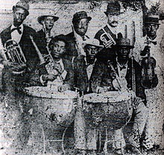
Son Cubano
A few instrumentalists furthered the son sound adding congas & more trumpet & percussion.
Son is the predominant musical force in Cuba and the symbol of the island. Structurally, there are two parts: an opening verse followed by a montuno section in which the improvising singer is answered by a chorus. Sones are centered upon a clave rhythm.
In the late 1920s, a trumpet was added and the son began to swing.
By the 1940s, Cuban son had become part of the main-stream popular music in North and South America as well as the Caribbean.
Notes:
http://www.justsalsa.com/salsa/music/son/

Slide 38
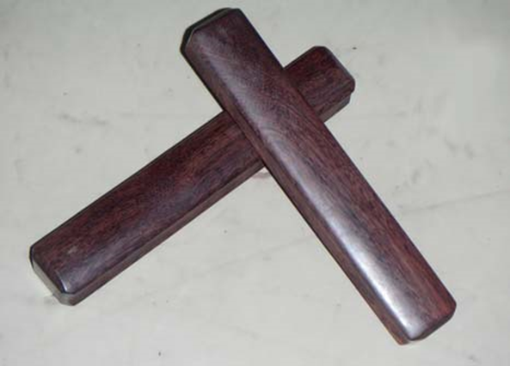
Los Claves https://www.youtube.com/watch?v=yaRJM76b8dA at 1:06min
Constructed from two pieces of wood, the claves are a percussion instrument made from the type of hardwood used in the construction of boats: rosewood, ebany, or granadilla. Upon striking one cylinder with the other a sound is produced which rises over all the other instruments, carries the rhythm, directs the melody and the steps of the dancers. The use of the claves began long ago in Cuba.

Slide 39
Notes:
https://www.youtube.com/watch?v=alUhI7WUnh4

Slide 40
Youtube resources for salsa music
https://www.youtube.com/watch?v=PEGMxMmWSVM (son Cubano in the streets)
https://www.youtube.com/watch?v=alUhI7WUnh4 (vivir mi vida)
https://www.youtube.com/watch?v=0fgvv5_Ys0k (Christina Aguilera slow salsa mix song)

Slide 41
Hoy vamos a…
Hacer el trabajo de la campana
Aprender de Hispanic Heritage Month
Aprender de Las Antillas:
Puerto Rico
La República Dominicana
Cuba
2.1, 2.2, 3.1, 3.2, 4.1, 4.2, & 5.1

Slide 42
END

