Slide 1
Hoy vamos a…
Bailar
Aprender de Ecuador
Enseñar la salsa
2.1, 2.2, 3.1, 3.2, 4.1, 4.2, & 5.1

Slide 2
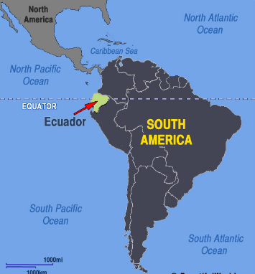
ECUADOR

Slide 3
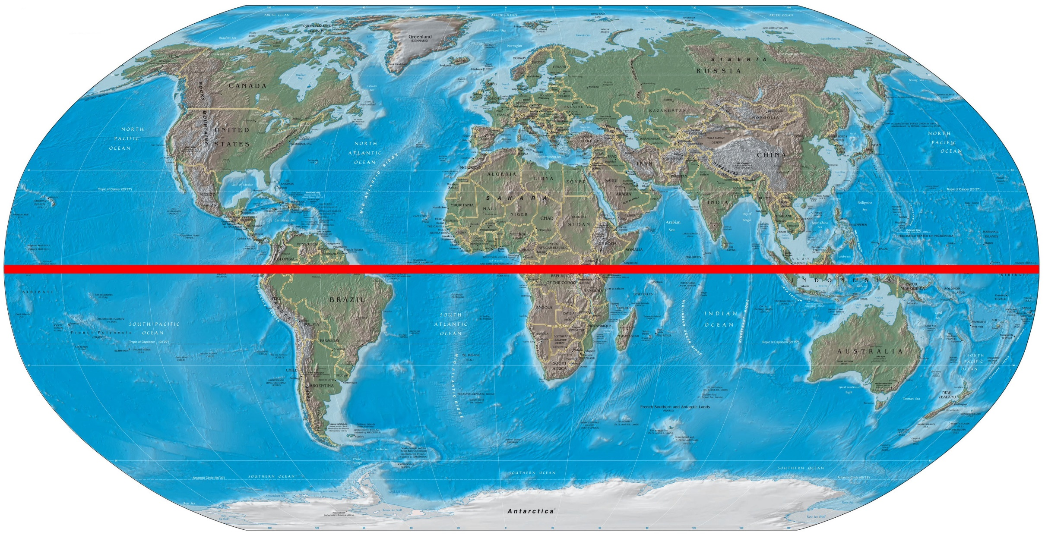
Ecuador, whose capital is Quito, is named after the Spanish word for equator because the equator passes through Ecuador.

Slide 4
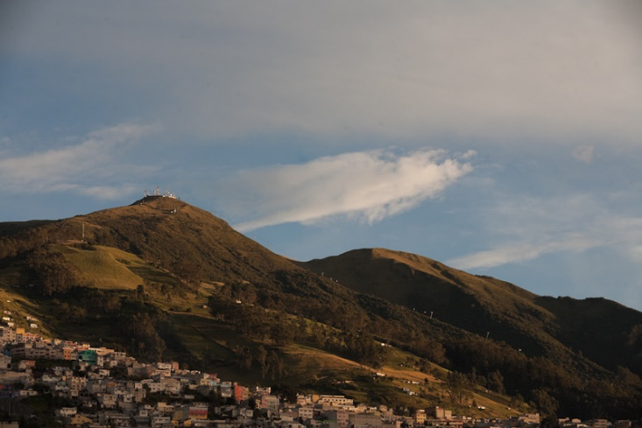
Because of its location at the equator, Ecuador does not experience variations in daylight hours during the course of a year. Sunrise and sunset are almost always at 6:00 a.m. and 6:00 p.m., respectively.

Slide 5
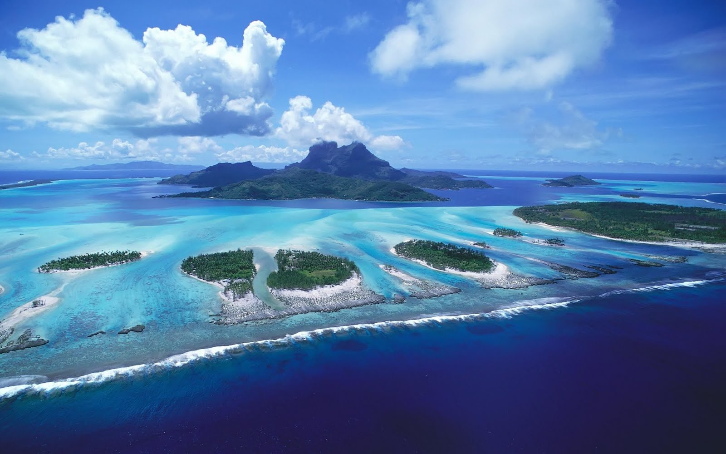
The Galápagos Islands belong to Ecuador and are famous for their vast variety of animal species and the studies by Charles Darwin that contributed to the inception of Darwin's theory of evolution by natural selection.

Slide 6
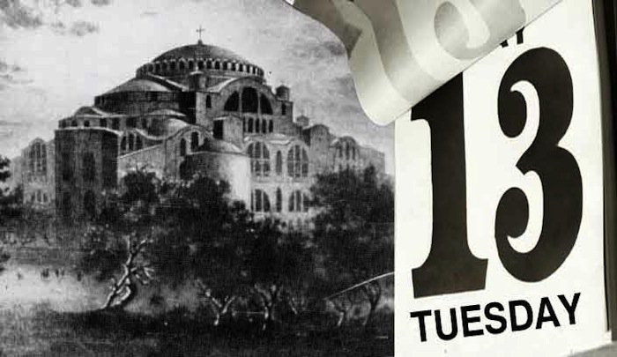
In Ecuador, Tuesday
the 13th is considered a very unlucky day. They believe that no one should ever get married or travel on that day.

Slide 7
Día de Independencia Ecuatoriano, 10 de agosto 1809
On August 9, 1809, the leaders of the patriots, Juan Pío Montúfar and Doctor Francisco Eugenio de Santa Cruz, organized a meeting at Señora Manuela Cañizares’ home.
The following day, on August 10, 1809, the patriots informed the current president of his deposition & declared independence of the territories of Quito.
There were still uprisings & turmoil from 1809 to 1829. However, with the peace treaty of Gran Colombia in 1829, Ecuador really attained true independence.
Becoming unified as 1 country in peace by 1830, the Venezuelan general, Juan José Flores, was appointed President of the Republic of Ecuador. President Flores reaffirmed the emancipation & the August 10, 1809 spirit & declaration of Independence.

Slide 8
Yellow symbolizes the abundance of crops & the fertility of the land.
Blue represents the color of the sea & the sky.
The red means the blood shed by the soldiers and martyrs of the battles of independence.
Though Independence came in the early 1800’s, the flag went through 6 stages of development. The current one was established in 1900 by legislative decree.

Slide 9
Cultura
The Afro-Ecuadorians that are present in Ecuador today are famous for their marimba music & many music and dance festivals. Long before the Spanish conquered Ecuador and even before the rise of Incan civilization, the diverse native cultures of the region had rich musical traditions. Music played an important role in the ancient Andean people’s lives and archaeologists have found some very old instruments, such as, drums, flutes, trumpets and other musical artifacts, in ancient tombs.
Ecuador has some very tasty and very strange combinations in their cuisine. You can expect to find some lemon marinated shrimps, toasted corn on the cob and a huge variety of pastries filled with all types of different stuffing.
Ecuador's official language is Spanish, but Quichua - an Incan language - is spoken by the Indian population. Besides Spanish, ten native languages are spoken in Ecuador. English is the most spoken foreign language amongst tourism service providers and professionals.
The Ecuadorians have a distinctive type of dress code. The men & especially the woman in each region of Ecuador and the Galapagos Islands can be easily identified by their dress as it is displays specific cultural diversities that are characteristic of that particular region. A major aspect of Indian identity is present in Ecuador. People that are familiar with the native dress can often tell roughly where an Indian is from, based on what they wear.
Notes:
http://www.ecuador.com/culture/

Slide 10
La Marimba Ecuatoriana “La Caderona” https://www.youtube.com/watch?v=ezpoPeN27Ts

Slide 11
Hoy vamos a…
Unit 3
Examen: lunes el 18 de septiembre (18/9/2017)
Themes/Topics:
Bailar
Aprender de Ecuador
Enseñar la salsa
Hispanic Heritage Month
Geography of 21 Spanish-speaking countries with nationalities
Culture
2.1, 2.2, 3.1, 3.2, 4.1, 4.2, & 5.1

Slide 12
Notes:
https://www.youtube.com/watch?v=alUhI7WUnh4

